Slide 1
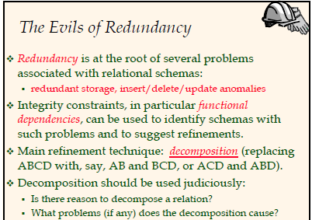

Slide 2
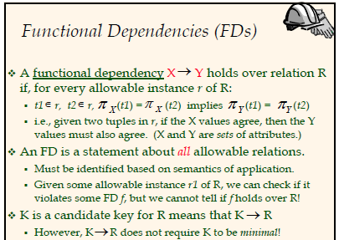

Slide 3
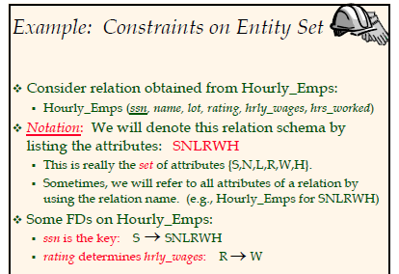

Slide 4
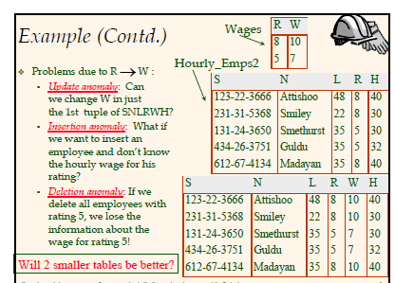

Slide 5
Functional Dependencies
AB →C
But if we add another row (a1,b1,c2,d1) FD is violated.
In the next slide we have ssn →did as ssn is the key, and we have the FD did → lot. We then get ssn →lot
A | B | C | D
a1 | b1 | c1 | d1
a1 | b1 | c1 | d2
a1 | b2 | c2 | d1
a2 | b1 | c3 | d1

Slide 6
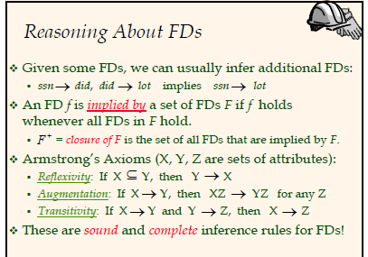

Slide 7
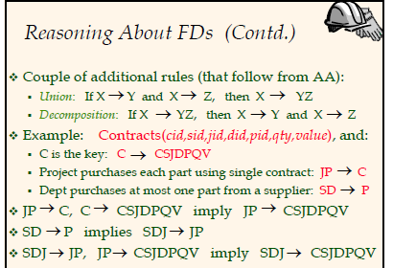
Contractid, supplierid, projectid, deptid, partid qty, value

Slide 8
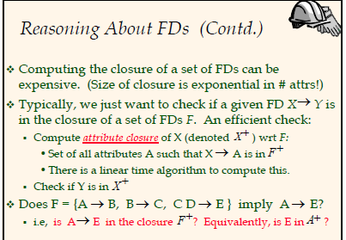

Slide 9
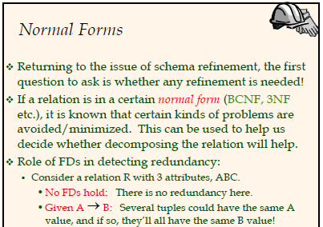

Slide 10
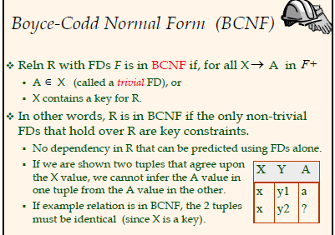

Slide 11
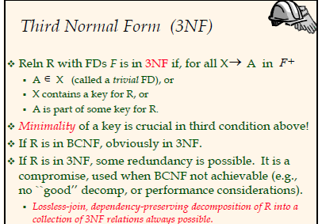

Slide 12
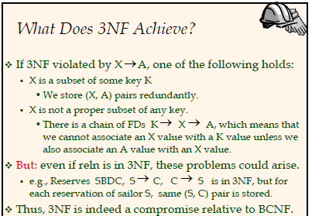

Slide 14
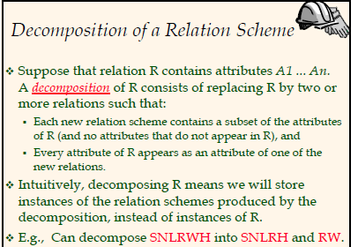

Slide 15
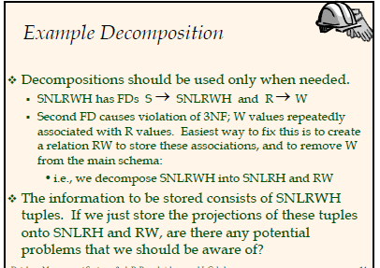

Slide 16
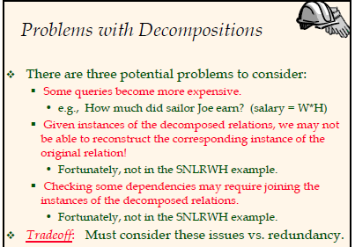

Slide 17
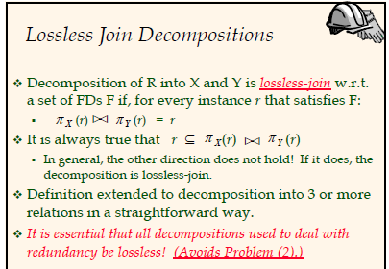

Slide 18
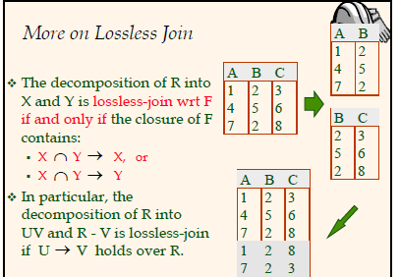

Slide 19
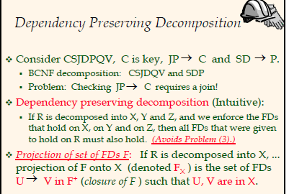

Slide 20
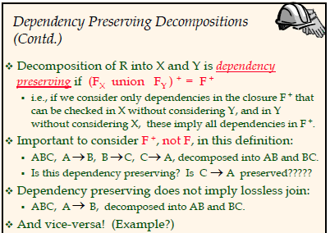

Slide 21
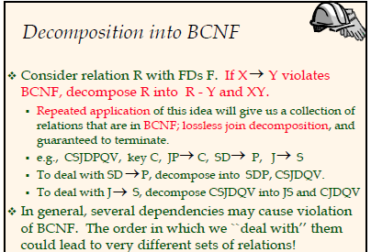

Slide 22
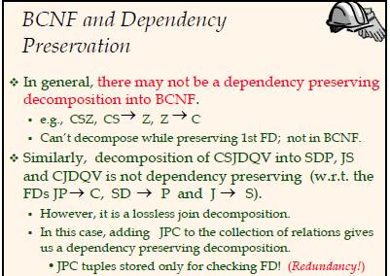

Slide 23
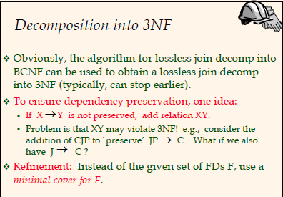

Slide 24
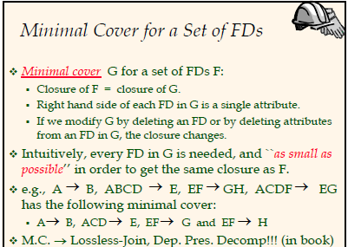

Slide 25
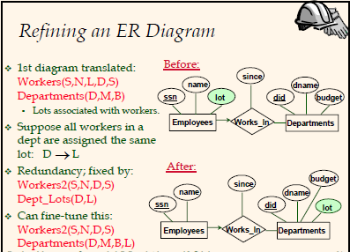

Slide 26
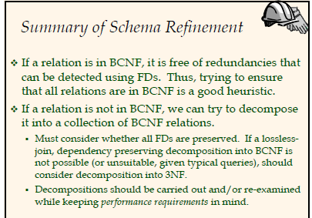

Slide 47
Example: Constraints on Entity Set
􀂙 Consider relation obtained from Hourly_Emps:
􀂃 Hourly_Emps (ssn, name, lot, rating, hrly_wages, hrs_worked)
􀂙 Notation: We will denote this relation schema by
listing the attributes: SNLRWH
􀂃 This is really the set of attributes {S,N,L,R,W,H}.
􀂃 Sometimes, we will refer to all attributes of a relation by
using the relation name. (e.g., Hourly_Emps for SNLRWH)
􀂙 Some FDs on Hourly_Emps:
􀂃 ssn is the key: S SNLRWH
􀂃 rating determines hrly_wages: R W

Slide 48
The Evils of Redundancy
Redundancy is at the root of several problems
associated with relational schemas:
redundant storage, insert/delete/update anomalies
Integrity constraints, in particular functional
dependencies, can be used to identify schemas with
such problems and to suggest refinements.
􀂙 Main refinement technique: decomposition (replacing
ABCD with, say, AB and BCD, or ACD and ABD).
􀂙 Decomposition should be used judiciously:
􀂃 Is there reason to decompose a relation?
􀂃 What problems (if any) does the decomposition cause?

Slide 49
Functional Dependencies (FDs)
􀂙 A functional dependency X Y holds over relation R
if, for every allowable instance r of R:
􀂃 t1 r, t2 r, (t1) = (t2) implies (t1) = (t2)
􀂃 i.e., given two tuples in r, if the X values agree, then the Y
values must also agree. (X and Y are sets of attributes.)
􀂙 An FD is a statement about all allowable relations.
􀂃 Must be identified based on semantics of application.
􀂃 Given some allowable instance r1 of R, we can check if it
violates some FD f, but we cannot tell if f holds over R!
􀂙 K is a candidate key for R means that K R
􀂃 However, K R does not require K to be minimal!

